Slide 1
The age of rename() is over*
Steve Loughran
December 2018
(*mostly)

Slide 2

Me: stevel@apache.org
Hadoop committer ~10 years
Object storage
The lower bits of your stack traces belong to me

Slide 3
Why do we save data?

Slide 4
Publish data for other applications
Process data published by other applications
Persist state for future instances of an application
Work with more data than fits into RAM
Share data with other instances of same application
Save things people care about & want to get back

Slide 5
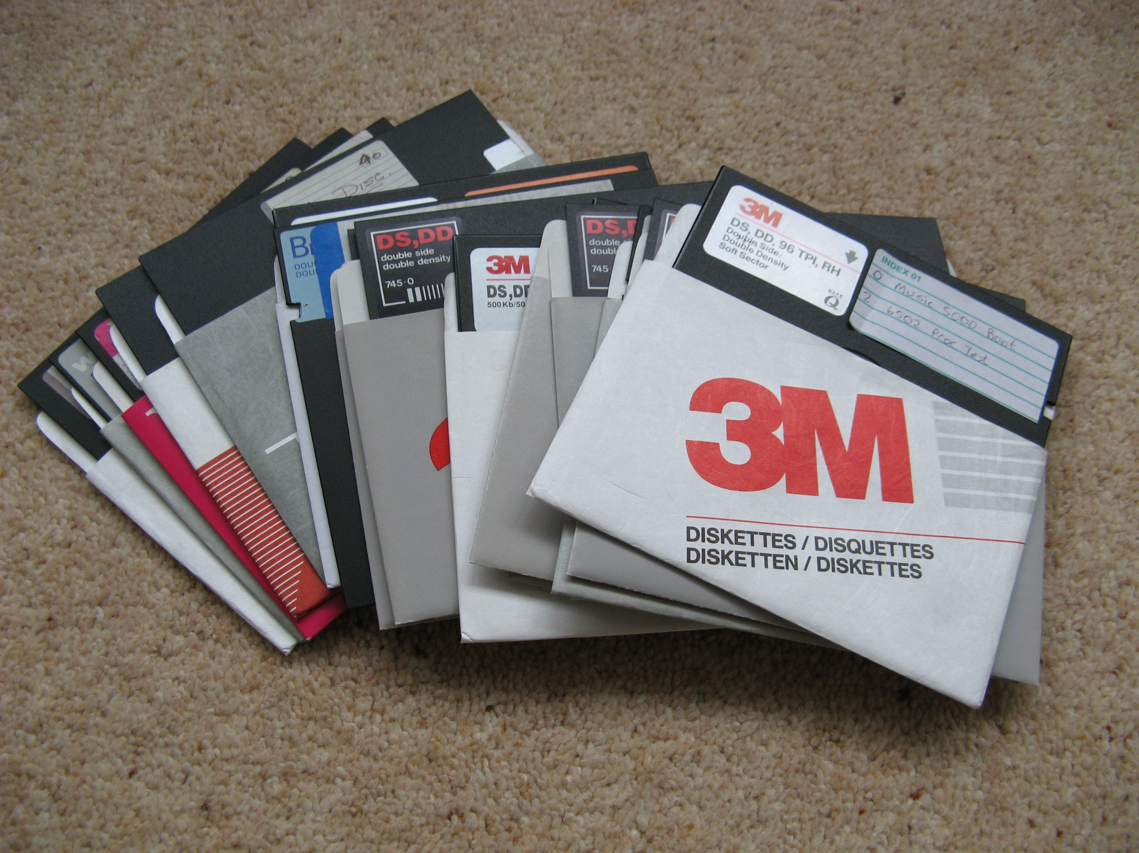
FAT8
dBASE II & Lotus 1-2-3
int 21h
Notes:
Trivia: dir rename only came with DOS 3.0

Slide 6
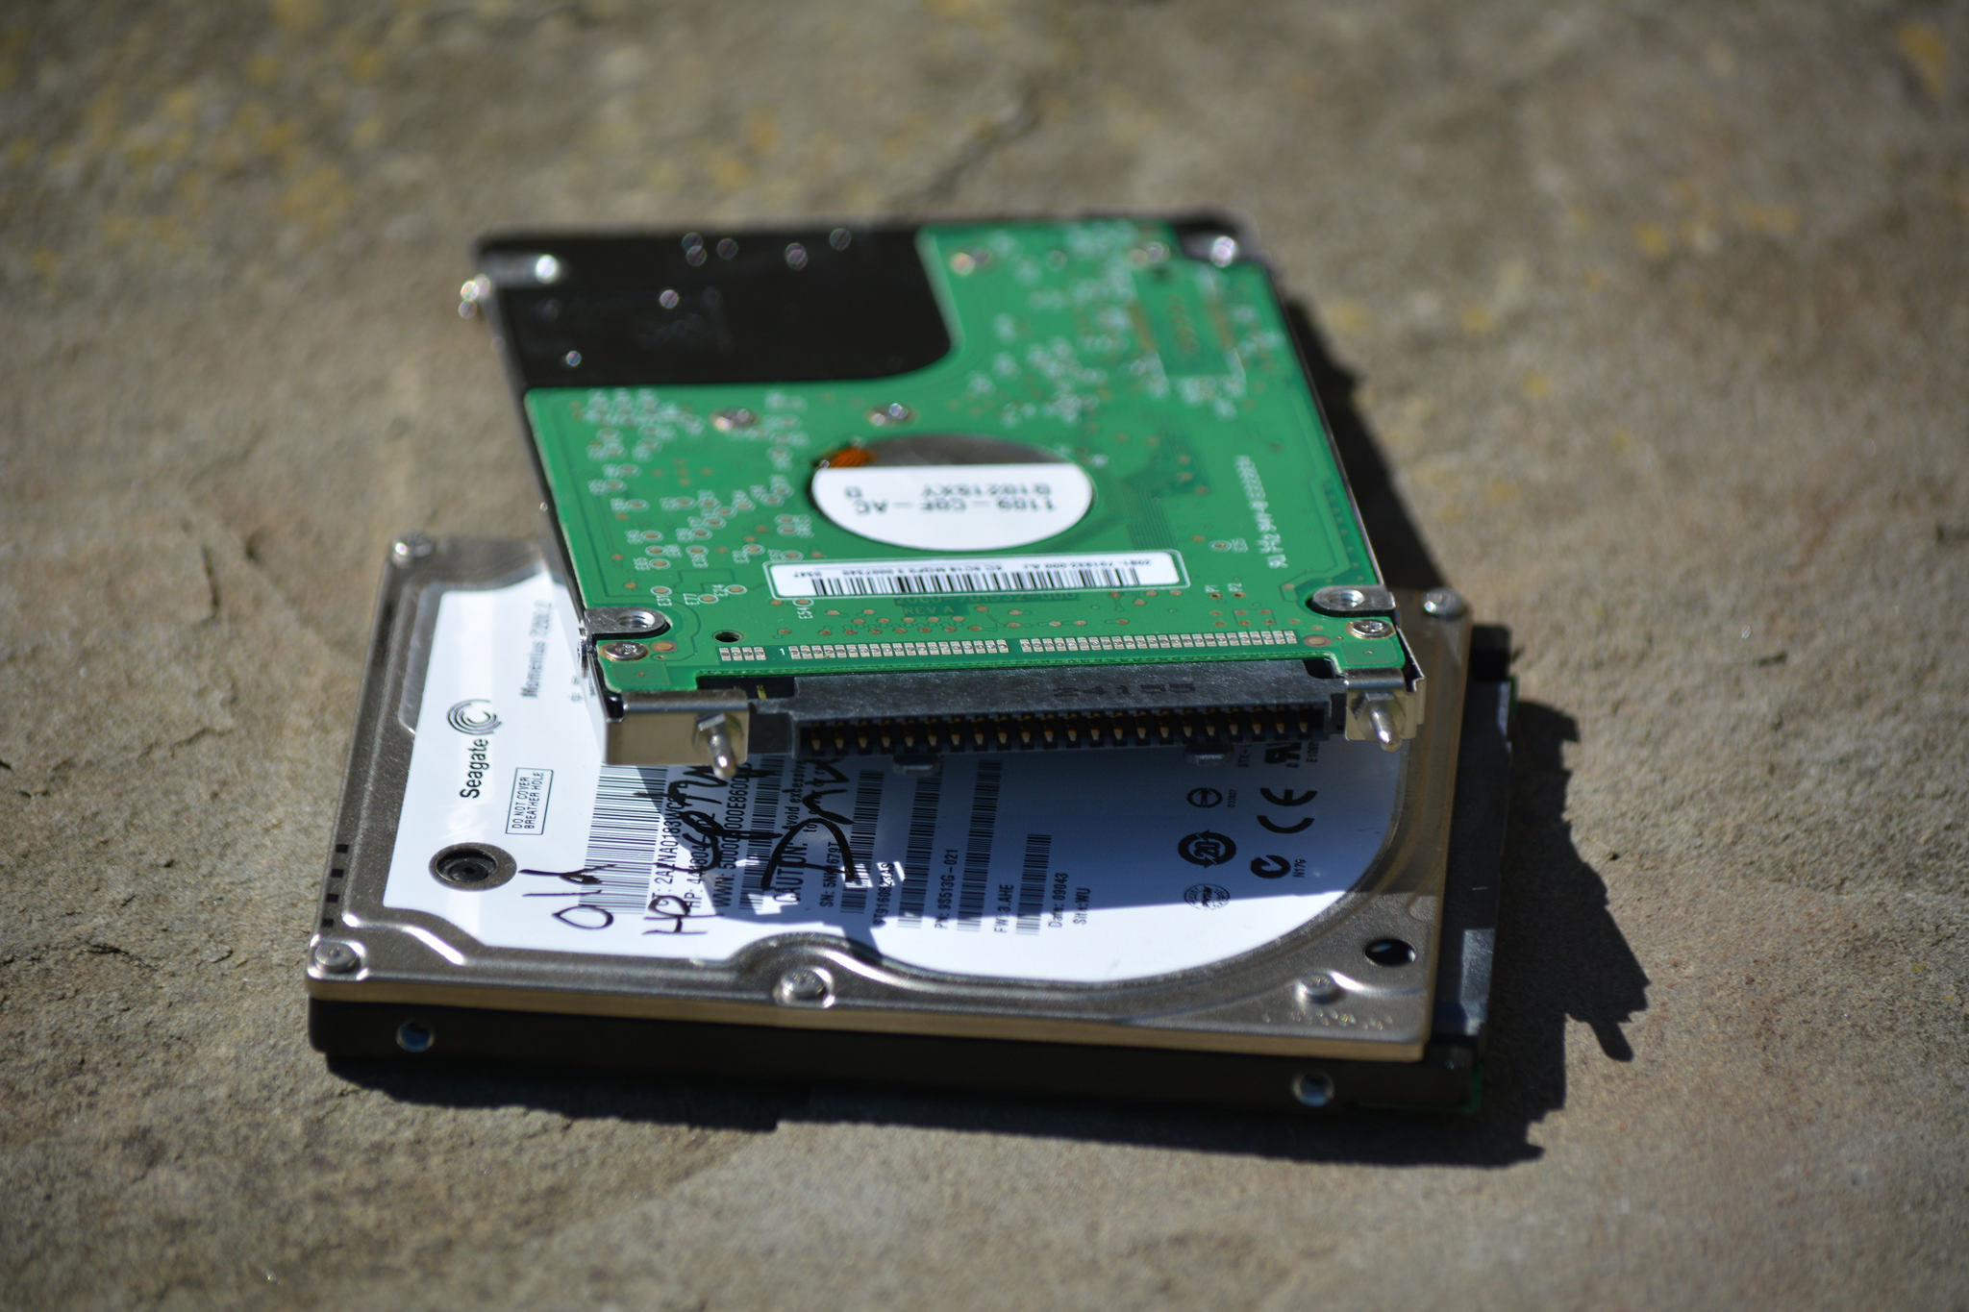
Linux: ext3, reiserfs, ext4
sqlite, mysql, leveldb
open(path, O_CREAT|O_EXCL)
rename(src, dest)
Windows: NTFS
Access, Excel
CreateFile(path)
MoveFileEx(src, dest)

Slide 7

Facebook Prineville Datacentre
1+ Exabyte on HDFS + cold store
Hadoop, Hive, Spark, Kafka, ...
Notes:
Facebook prineville photo store is probably at the far end of the spectrum

Slide 8
Model and APIs

Slide 9
Model #1: File-System
Directories and files
Posix with stream metaphor

Slide 10









Posix: hierarchical (distributed?) filesystems
org.apache.hadoop.fs.FileSystem
hdfs
wasb
s3a
swift
adl
gcs
Notes:
Everything usies the Hadoop APIs to talk to both HDFS, Hadoop Compatible Filesystems and object stores; the Hadoop FS API. There's actually two: the one with a clean split between client side and "driver side", and the older one which is a direct connect. Most use the latter and actually, in terms of opportunities for object store integration tweaking, this is actually the one where can innovate with the most easily. That is: there's nothing in the way.
Under the FS API go filesystems and object stores.
HDFS is "real" filesystem; WASB/Azure close enough. What is "real?". Best test: can support HBase.

Slide 11
val work = new Path("s3a://stevel-frankfurt/work")
val fs = work.getFileSystem(new Configuration())
val task00 = new Path(work, "_temp/task00")
fs.mkdirs(task00)
val out = fs.create(new Path(task00, "part-00"), false)
out.writeChars("hello")
out.close();
fs.listStatus(task00).foreach(stat =>
fs.rename(stat.getPath, work)
)

Slide 12
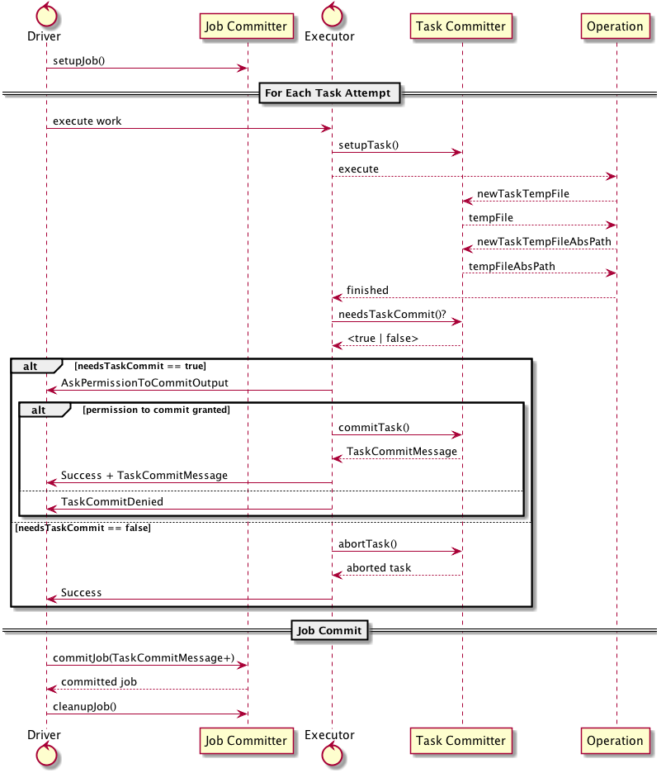
Apache Spark Commit Protocol

Slide 13
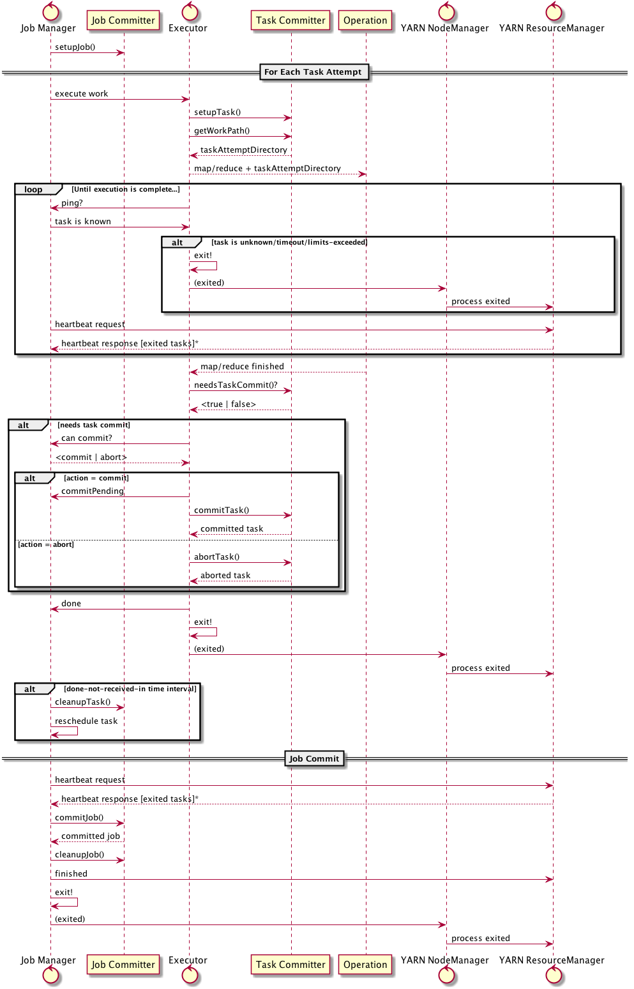
MapReduce Commit Protocol

Slide 14
rename() gives us O(1) atomic task commits
/
Datanode-01
Datanode-02
HDFS Namenode
work
00
01
00
_temp
part-01
task-00
task-01
01
00
part-00
part-01
01
rename("/work/_temp/task00/*", "/work")
Datanode-03
Datanode-04
Notes:
This is how we commit work in Hadoop FileOutputFormat, and so, transitively, how Spark does it too (Hive does some other things, which I'm ignoring, but are more manifest file driven)

Slide 15
Amazon S3 doesn't have a rename()
/
S3 Shards
work
00
01
01
00
_temp
part-01
task-00
task-01
01
00
part-00
part-01
01
01
LIST /work/_temp/task-01/*
01
COPY /work/_temp/task-01/part-01 /work/part-01
DELETE /work/_temp/task-01/part-01

Slide 16
Fix: end the metaphor
work/part-01
work/part-00
00
01
00
POST /work/part-01?uploads => UploadID
POST /work/part01?uploadId=UploadID&partNumber=01
00
POST /work/part01?uploadId=UploadID&partNumber=02
01
01
POST /work/part01?uploadId=UploadID&partNumber=03

Slide 17
job manager selectively completes the uploads
work/part-01
work/part-01
work/part-00
00
01
01
00
POST /work/part-01?uploadId=UploadID <CompleteMultipartUpload> <Part> <PartNumber>01</PartNumber><ETag>44a3</ETag> <PartNumber>02</PartNumber><ETag>29cb</ETag> <PartNumber>03</PartNumber><ETag>1aac</ETag> </Part> </CompleteMultipartUpload>
00
01
01
01
01

Slide 18
S3A O(1) zero-rename commit demo!

Slide 19
What else to rethink?
s/Directories/r/patterns/
seek()+read() sequences ==> Scatter/Gather IO
Blocking operations ==> async block reads executed out of order
TODO: How to work with Eventually Consistent data?
HADOOP-11867

Slide 20
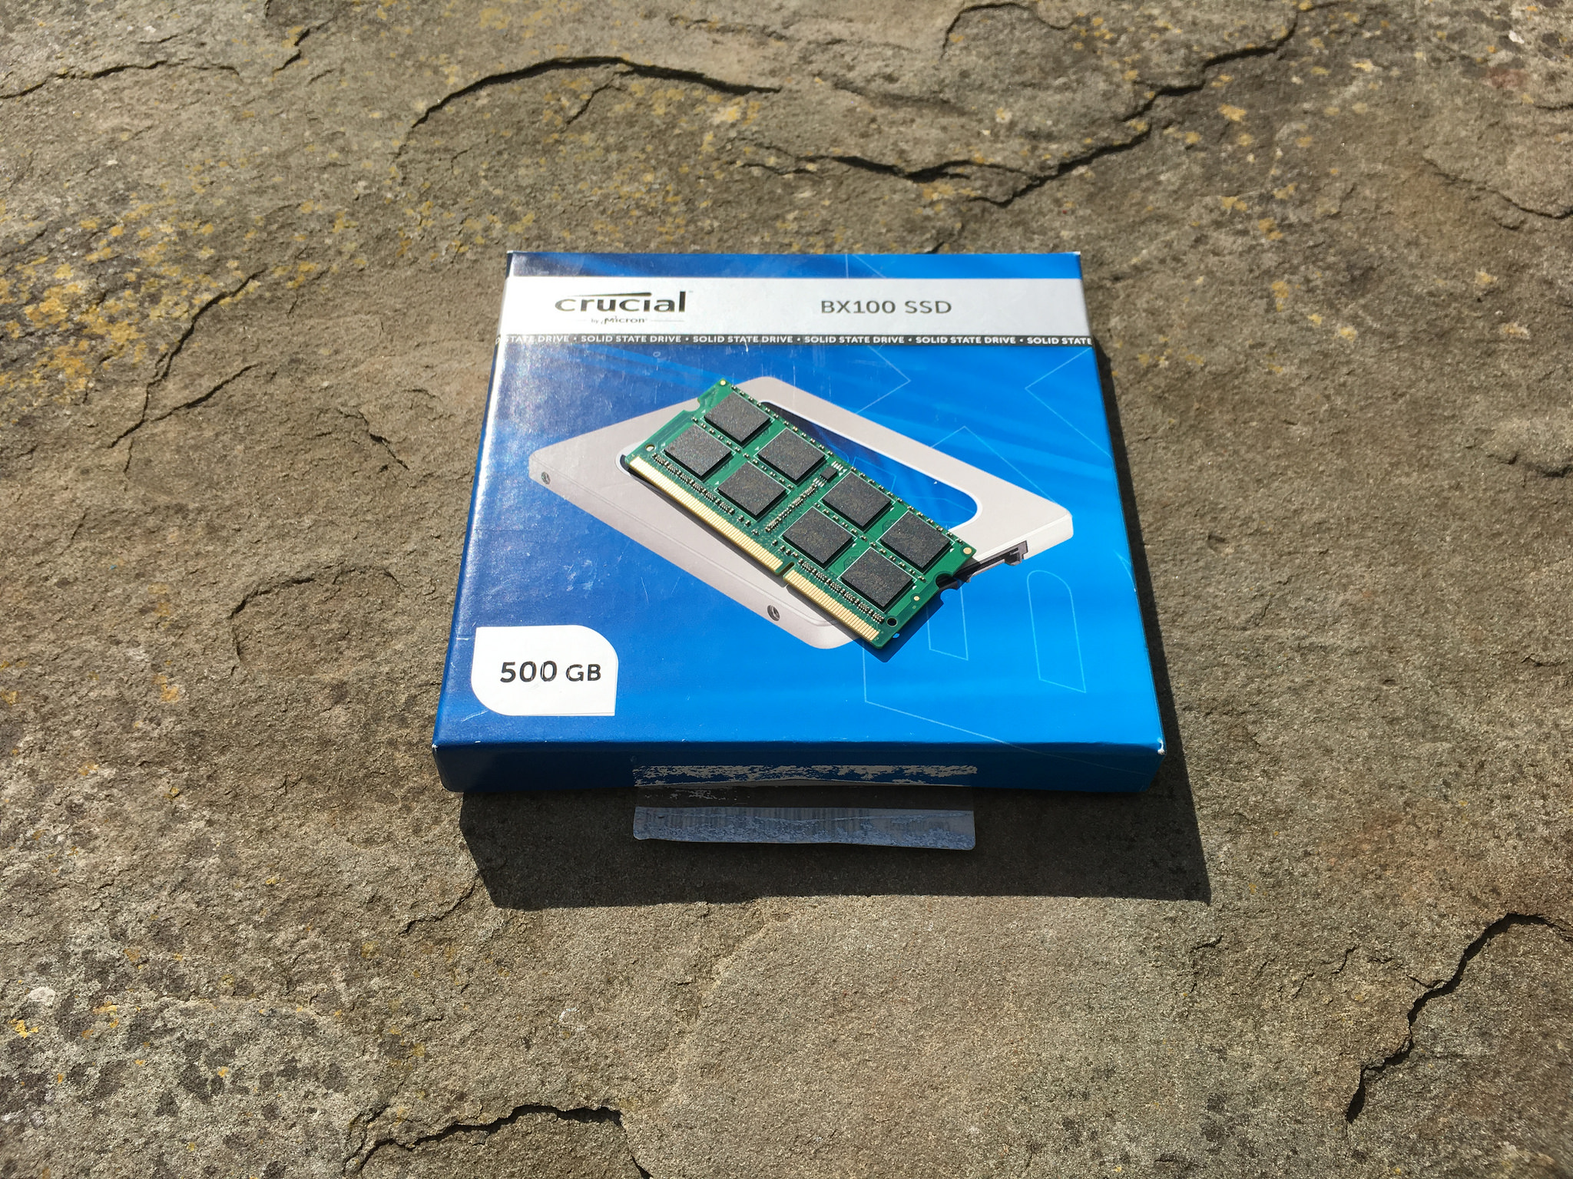
Model and API #2: memory
SSD via SATA
SSD via NVMe/M.2
Future NVM technologies

Slide 21
typedef struct record_struct {
int field1, field2;
long next;
} record;
int fd = open("/shared/dbase", O_CREAT | O_EXCL);
record* data = (record*) mmap(NULL, 8192,
PROT_READ | PROT_WRITE, MAP_SHARED, fd, 0);
(*data).field1 += 5;
data->field2 = data->field1;
msync(record, sizeof(record), MS_SYNC | MS_INVALIDATE);
Notes:
This is my rough guess at a C-level operation against mmaped data today. Ignoringthe open/sync stuff, then the writes in the middle are the operations we need to worry about, as they update the datastructures in-situ. Nonatomically.

Slide 22
typedef struct record_struct {
int field1, field2;
record_struct* next;
} record;
int fd = open("/shared/dbase");
record* data = (record*) pmem_map(fd);
// lock ?
(*data).field1 += 5;
data->field2 = data->field1;
// commit ?
Notes:
This is my rough guess at a C-level operation against mmaped data today. Ignoringthe open/sync stuff, then the writes in the middle are the operations we need to worry about, as they update the datastructures in-situ. Nonatomically.

Slide 23
NVM moves the commit problem into memory I/O
How to split internal state into persistent and transient?
When is data saved to NVM? (cache flushed, sync in memory buffers, ...)
How to co-ordinate shared R/W access over RDMA?
Versioning?
How do we write apps for a world where rebooting doesn't reset our state?
Catch up: read "The Morning Paper" summaries of research
Notes:
Work like RAMCloud has led the way here, go look at the papers. But that was at RAM, not NVM, where we have the persistence problem
Some form of LSF model tends to be used, which ties in well with raw SSD (don't know about other techs, do know that non-raw SSD doesn't really suit LFS)
If you look at code, we generally mix persisted (and read back) data with transient; load/save isn't so much seriaiizing out data structures as marshalling the persistent parts to a form we think they will be robust over time, unmarshalling them later (exceptions: Java Serialization, which is notoriously brittle and insecure)
What apps work best here? Could you extend Spark to make RDDs persistent & shared, so you can persist them simply by copying to part of cluster memory?, e.g a "NVMOutputFormat"

Slide 24
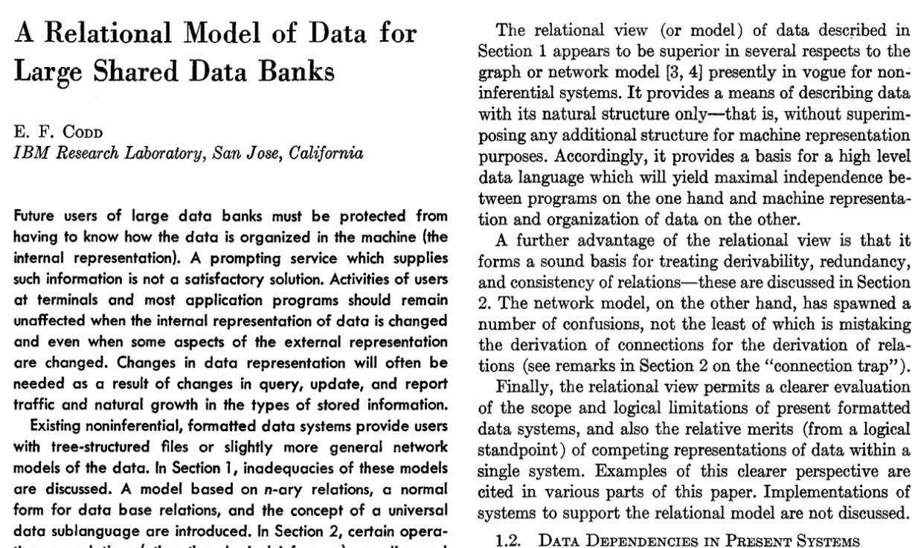
Model #3: SQL

Slide 25
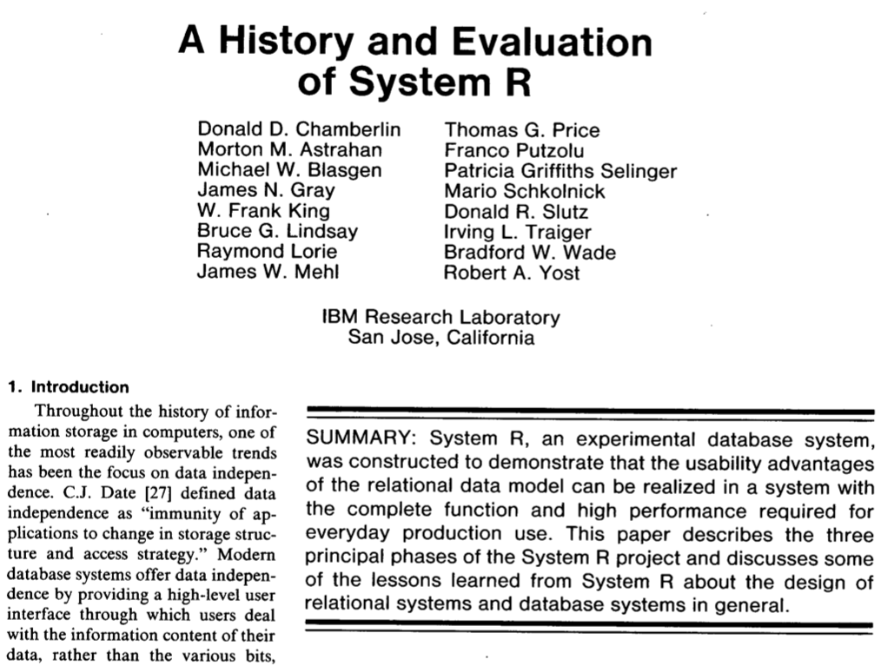

Slide 26
S3 Select: SQL in the object store
hadoop s3guard select -header use -limit 20 \
s3a://hwdev-steve-ireland-new/steve/boris.csv \
"SELECT * FROM S3OBJECT s WHERE \
endstation_name = 'Bayswater Road: Hyde Park'"
"9347774","1506","5903","04/01/2012 00:32","153","Bayswater Road: Hyde Park","04/01/2012 00:06","151","Chepstow Villas: Notting Hill"
"9348043","607","5365","04/01/2012 01:09","153","Bayswater Road: Hyde Park","04/01/2012 00:59","153","Bayswater Road: Hyde Park"
"9363308","708","5167","04/01/2012 06:30","153","Bayswater Road: Hyde Park","04/01/2012 06:18","404","Palace Gate: Kensington Gardens"
...

Slide 27
Summary: As storage changes so must the models
Object stores address scale & HA —at cost of semantics and performance
Non-Volatile Memory is the other radical change
Posix metaphor isn't suited to either —what next?
SQL makes all this someone else's problem (leaving only O/R mapping, transaction isolation...)

Slide 28
Questions?

